Slide 1
Capstone Project: Analytical CRM Development for a Bank
By
Keshav Kumar
22/04/2024

Slide 2
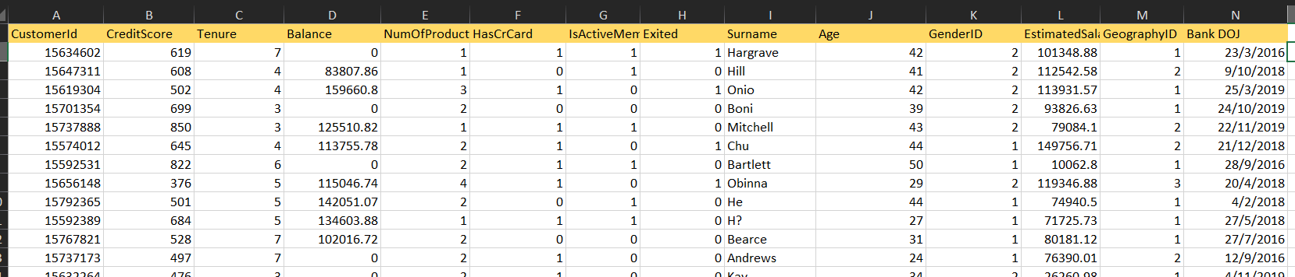
Problem Statement
I am an analytical CRM (Customer Relationship Management) specialist hired by a bank to extract meaningful insights from various customer-related datasets. The bank aims to reduce customer churn, improve service delivery, and enhance customer satisfaction. They have provided you with datasets including customer demographics, transaction details, customer exit information, and active customer profiles.

Slide 3
Data Description
RowNumber: The row number in the dataset, likely used for reference or indexing.
CustomerId: A unique identifier for each customer.
CreditScore: A numerical representation of the customer's creditworthiness.
GeographyID: A numerical identifier that likely corresponds to a geographical location, such as a country or region.
GenderID: A numerical identifier for the customer's gender, where for example, '1' could represent male and '2' could represent female.
Age: The age of the customer.
Tenure: The number of years the customer has been with the bank.
Balance: Current balance in the customer's account.
NumOfProducts: refers to the number of products that a customer has purchased through the bank.

Slide 4
Data Description
HasCrCard: denotes whether or not a customer has a credit card. This column is also relevant, since people with a credit card are less likely to leave the bank.
where 1 represents credit card holder and 0 represents non credit card holder
IsActiveMember: active customers are less likely to leave the bank (as per the criteria defined by the bank for identifying the activeness).
where 1 represents Active Member and 0 represents Inactive Member
Estimated Salary: as with balance, people with lower salaries are more likely to leave the bank compared to those with higher salaries.
Exited: whether or not the customer left the bank.
where 0 represents Retain and 1 represents Exit
Bank DOJ: date when the Customer associated/joined with the bank.

Slide 5
Methodology
Data Consolidation and Preprocessing with Excel: Consolidated seven spreadsheets into one by copying data from each sheet into a new sheet. Merged customerinfo and bank_churn datasets using customerid as the key. Resulting dataset named main_spreadsheet_data, saved for further use.
Data Storage and Manipulation with SQL: Converted date format from dd/mm/yy to yy/mm/dd for compatibility with SQL Workbench. Saved spreadsheet as CSV file with comma delimiter. Uploaded data to SQL Workbench into 'sqlproject' database for analysis.
Data Analysis and Visualization with Power BI: Created a Power BI dashboard for analyzing customer churn, using various KPIs and graphs. Visualizations include churn rate trends, customer retention metrics, and demographic breakdowns.
Objectives to Achieve with the Analysis: Determine the key factors contributing to customer churn.

Slide 6
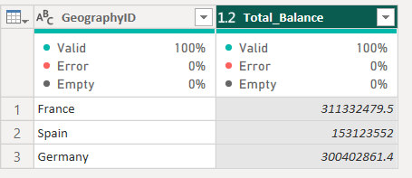
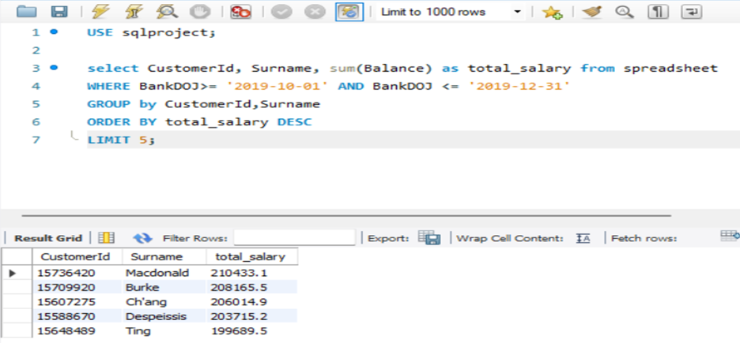
Objective Questions Analysis
France has the highest account balance among all 3 regions
Spain has the lowest account balance among all 3 regions.
In the last quarter of the year
Macdonald has the highest estimated
Salary.
Burke, Ch’ang, Despeissis and Ting are
The top other four.

Slide 7
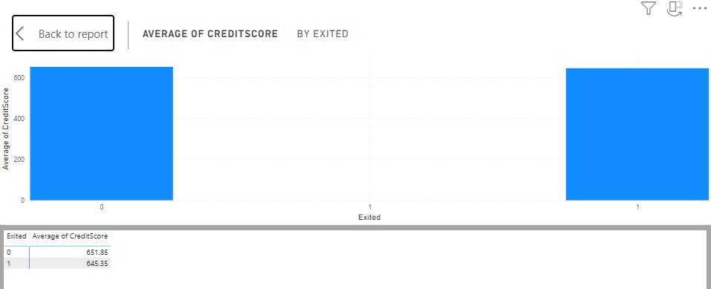
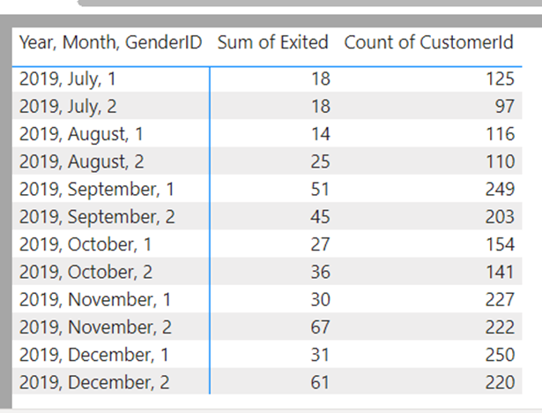
Objective Questions Analysis
The average Credit score of the
customer who has exited is 645.35.
The average credit score of the
customer who has retained in the
Bank is 651.85.
Churn rate= (Lost customer)/Total customer at the beginning of the period
In the most recent year 2019 churn rate of male (1) = (31/250)*100
= 12.4 %
In the most recent year 2019 churn rate of female (2) = (61/220)*100 = 27.7 %

Slide 8
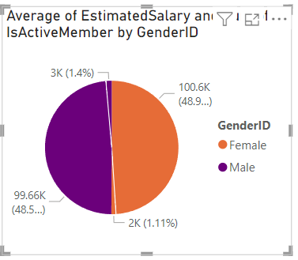
Objective Questions Analysis
Female has higher average of estimated salary amount
that is 100.6K approx.
The number of active members is 2k approx.
Male has lower average of estimated salary amount that
is 99.66k approx.
The number of active members is 3k approx.
Male are more active member than female.

Slide 9
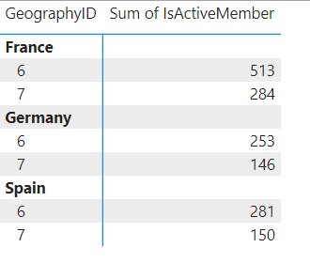
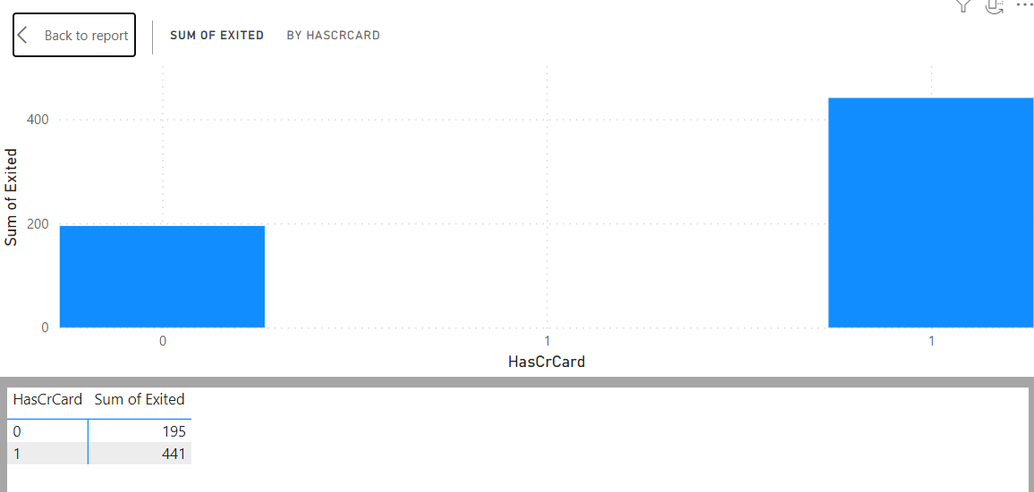
Objective Questions Analysis
The geographic region has the highest number of active customers with a
tenure greater than 5 years is France 797.
The poor credit score customer has the highest exit rate and the number
of such customer is 660 out of 3034.
The no of customer has credit card and exited is 441.
The no of customer has not credit card and exited is 195.
Means the number of exited customer is more in credit card
holder one.

Slide 10
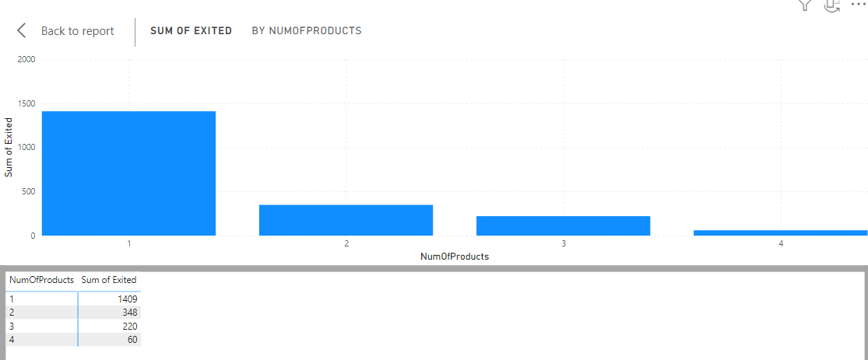
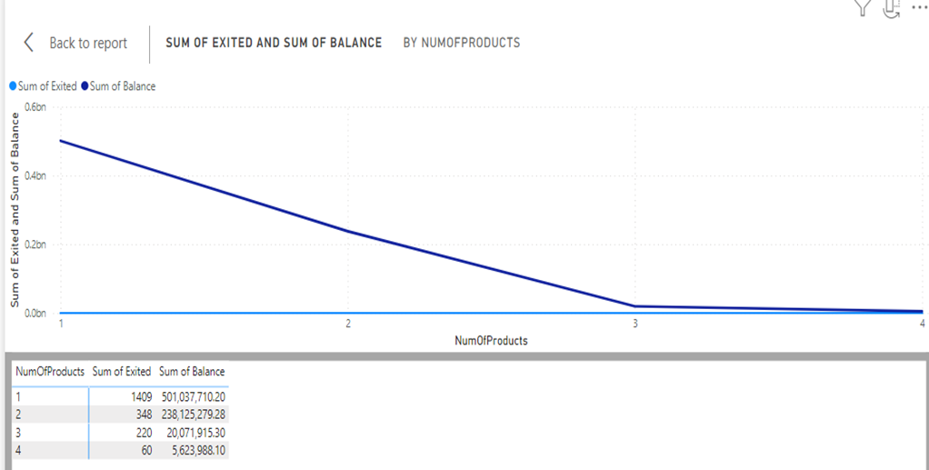
Objective Questions Analysis
The majority of customer who has exited
have used only one product of the
bank.
The number of exited customer is less
who have used more no of the bank
products.
The sum of account balance of exited customers
using one number of products is 501037710.20.
The sum of account balance of exited customers
using 2 number of products is 238125279.28
and so on.

Slide 11
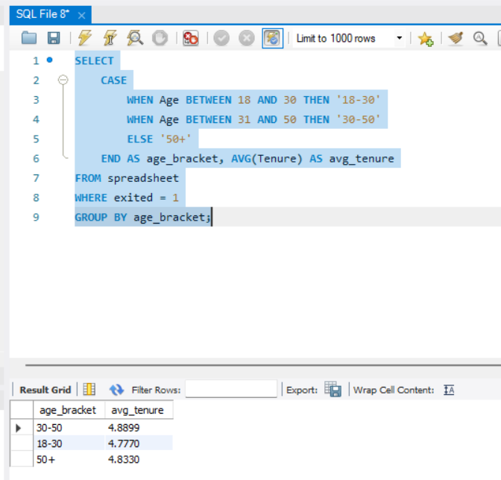
Objective Questions Analysis
The average tenure of the customer who has exited
in age group 30 to 50 is 4.9.
The average tenure of the customer who has exited
in age group 18 to 30 is 4.8.
The average tenure of the customer who has exited
in age group 50 + is 4.8.
Over all their average tenure is constant, that is 4.8.

Slide 12
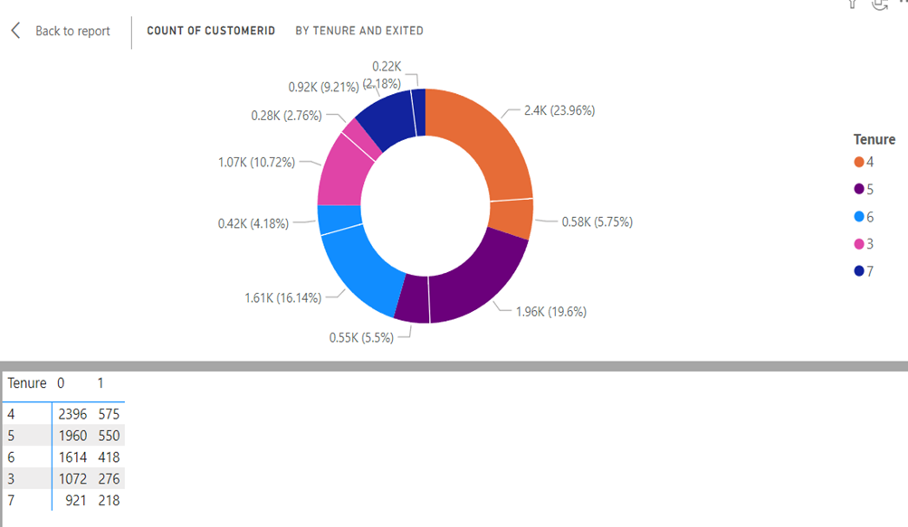
Subjective Questions Analysis
Customer Behaviour Analysis:
The 4 years tenure customers have 5.75% of
exit rate.
The 5 years tenure customers have 5.5% of
exit rate.
The 6 years tenure customers have 4.18% of
exit rate.
The 3 years tenure customers have 2.76% of
exit rate.
The 7 years tenure customers have 2.18% of
exit rate.
Means the oldest customers has more
belief on bank .

Slide 13
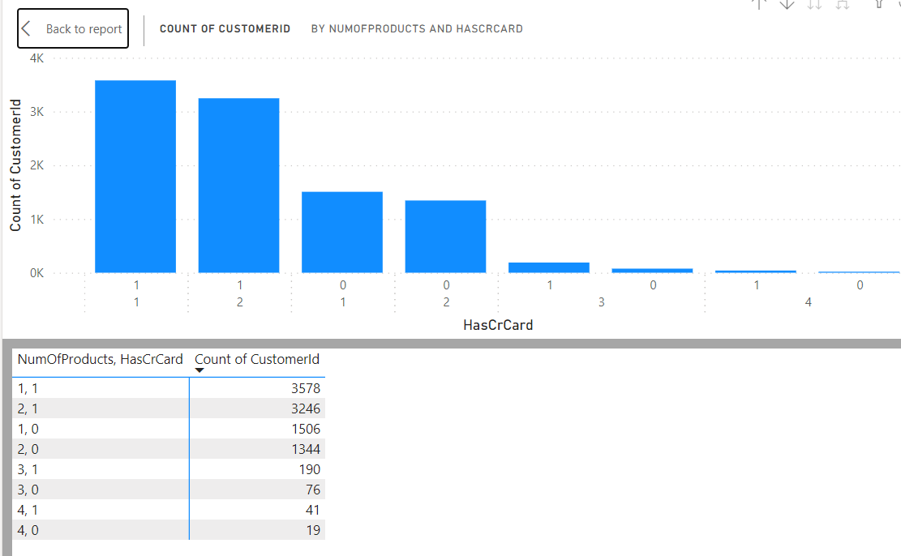
Subjective Questions Analysis
Product Affinity Study:
The customers using 1 number of
product as well as using credit card
is double than that of not using
credit card.
The customers using 2 numbers of
product as well as using credit card
is more then double than that of not
using credit card.
The customers using 4 number of
product is very less.
We have to promote the numbers
of products and credits cards in bank.

Slide 14
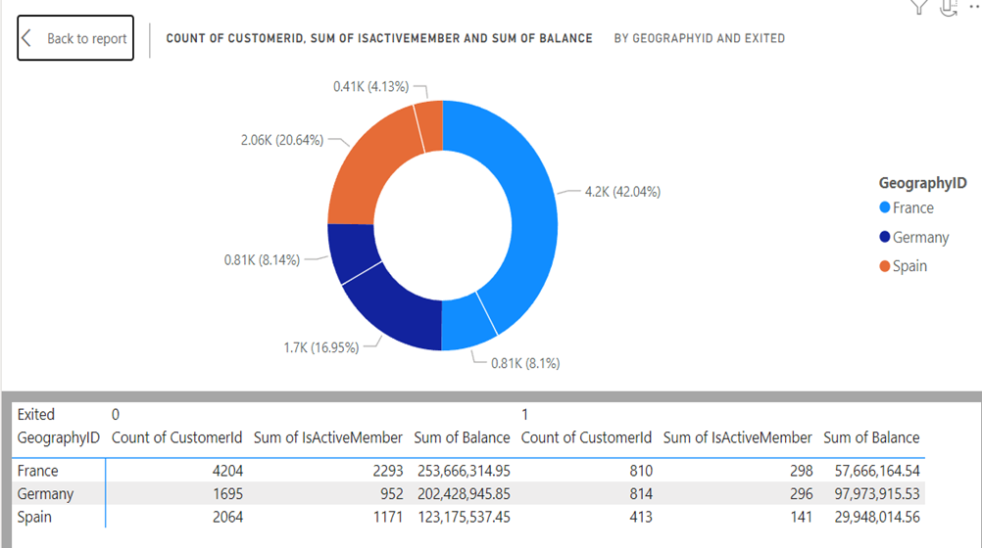
Subjective Questions Analysis
Geographic Market Trends:
France has the highest number of
customers along with the highest
number of active members.
Germany has the lowest number of
customers and the lowest number
of active members.
In the sum of balance France
stands at first, Germany stands at
second and Spain stands at third
position.
As per the number of customers France stands at first, Spain stands at second and Germany stands at third position.

Slide 15
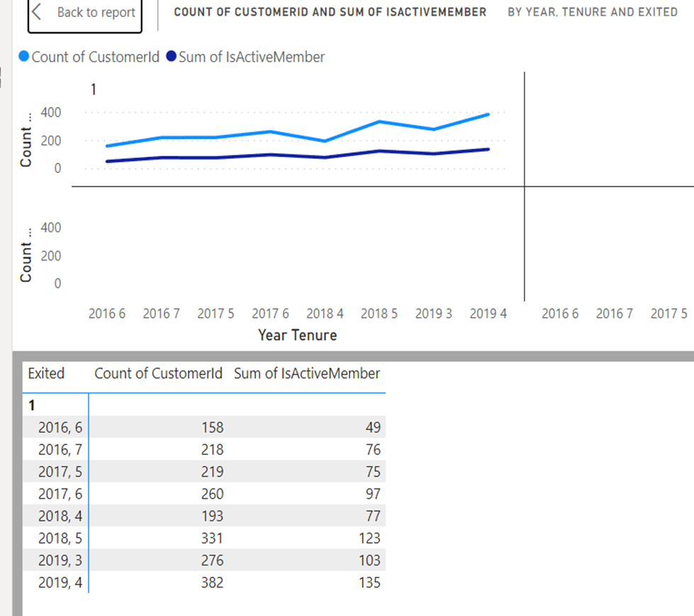
Subjective Questions Analysis
Customer Tenure Value Forecast:
The number of customers exited in year
2019 is 382 in which 135 was active
members, they had 4 years of tenure.
The number of customers exited in year
2019 is 276 in which 103 was active
members they had 3 years of tenure.
The number of customers exited in year
2016 and tenure 6, 7 years is less.
Overall we can say that the exit number of
higher tenure customer is less and active
members in them is minimal.

Slide 16
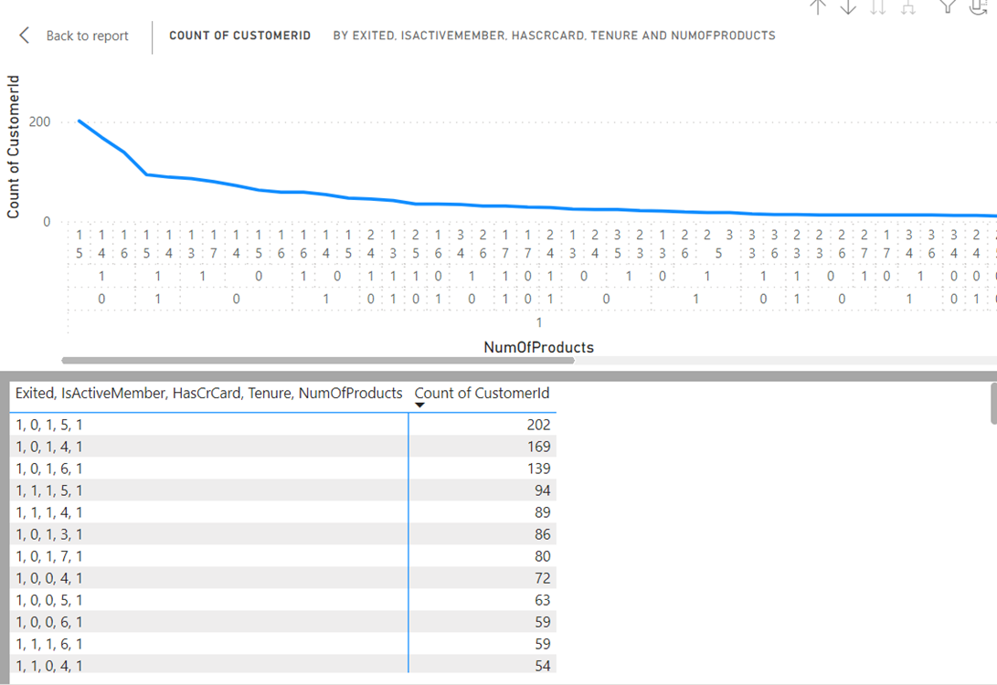
Subjective Questions Analysis
Customer Exit Reasons Exploration:
The highest number of customer who
exited the bank was not the active
members.
The tenure of the highest number of
exited customers are 4 and 5years.
The highest number of exited
customers are involving in only one
type of bank product.

Slide 17
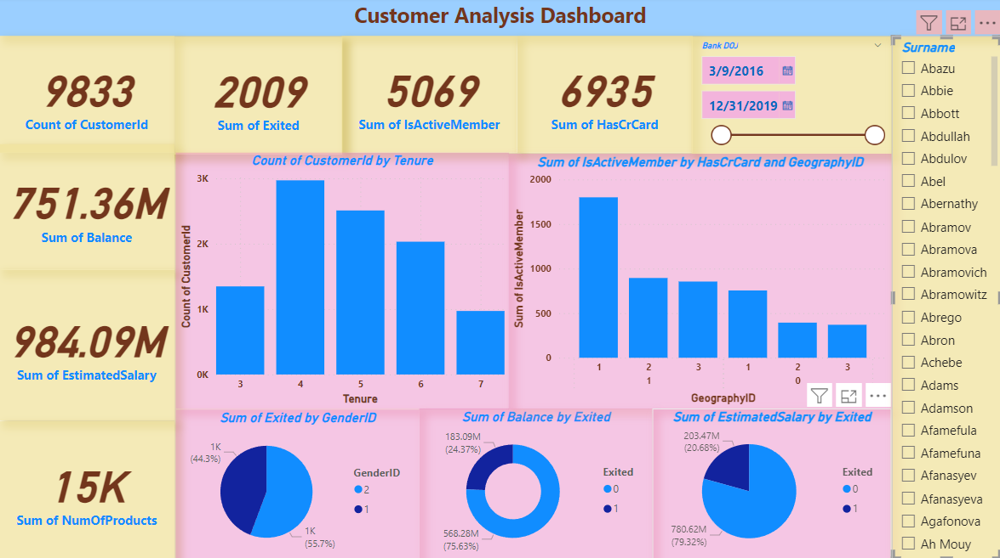
Final Dashboard

Slide 18
Conclusion
It's evident that customer tenure, product engagement, and active membership are key factors influencing churn rates in the bank. Customers with shorter tenures and those using fewer bank products are more likely to churn, highlighting the importance of nurturing long-term relationships and promoting additional products. Additionally, the data indicates variations in churn rates across different customer segments and countries, suggesting the need for tailored retention strategies. By focusing on enhancing customer engagement, offering personalized services, and leveraging data analytics for targeted campaigns, the bank can effectively reduce churn and improve customer retention.

Slide 19

.

